Slide 1
Video Analytics
Team - Codingly

Slide 2
Problem statement
Banks are using video cameras for the purpose of surveillance at many branches, ATMs and digital lobbies. Getting video analytics of different parameters from the video recording will help the bank to resolve many operational issues at the branches. The bank wants to explore video analytics to understand the customer sentiments, understand the patterns /behaviors/actions in certain branches for proactive surveillance and provide better services to customers.

Slide 3
Solution expected
Constantly scanning multiple video footage for:
1. Sentiments of customers
2. Tampering with the cameras / sensitive or high priority area within premises.
3. Count of People
4. Any activity that needs attention
5. Time taken for activity on premises
6. Identification of known facilitators
7. Feedback mechanism for false positives / incorrect classification for enhancement in model

Slide 4
Proposed solution
With opencv in python, person detection can be implemented. With the help of YOLO V4 and Deepsort algorithm, person tracking and person count can determined.
The person count is found by placing a divider in the opencv frame at the entrance of the Bank or ATM, so that it can be considered as a reference.
The emotions of the customers can be tracked using motion detection by detecting the movement of the individual.
If any type of emotion that requires attention will be sent to the staffs at the Bank.
Also Time taken for activity on premises can be found.

Slide 5
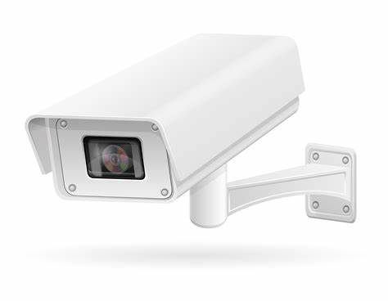




Proposed solution
cctv
ML
Required assistance
If any Tampering

Slide 6
Technology stack
Python 3
OpenCv
Tensorflow
YOLO V4
Deepsort
AI & ML

Slide 7
Thank you

